Slide 1
Python
Session – 5
Date – 19th May, 2022

Slide 2
Functions in Python
Python Function is a piece of code or any logic that performs the specific operation. We already saw some methods until now, and you may not notice them. For instance, print(), factorial(), round(), etc., are few of the built-in functions in Python programming language.
We don’t have to bother about the logic inside the Library or built in functions in Python Programming Language. In our previous articles, We used many library methods such as print(), factorial(), round() etc.
User Defined: Instead of relying on built-in, Python programming language allows us to create our own called as user defined functions. For example, if we want to implement some mathematical calculations, then put them in separate methods with the correct name. Then we can call that method multiple times.

Slide 3
Advantages of functions in Python
It helps to divide the large programs into small groups so that we can read the code, and debug the program faster and better.
Python Functions stop us from writing the same logic various times. We can bind the logic in one def and then call the same over and over.
Many persons can work on the same program by assigning different methods to each of them.
It encourages us to call the same method with different inputs over multiple times.

Slide 4
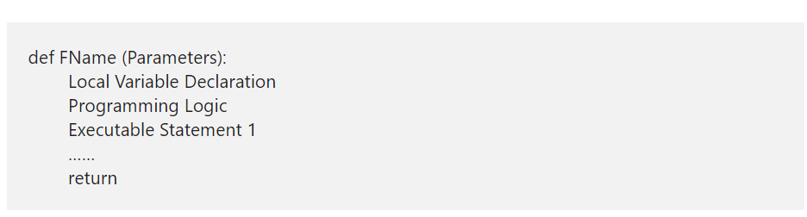
Python Define Functions Syntax

Slide 5
Python Define Functions Syntax Contd.
def: Keyword def is the introduction to the definition. Remember, the Python def keyword must immediately follow by the Name to define it.
FName: It can be any name you wish to give other than the system reserved keywords.
Parameters: Every python function accepts 0 or more parameters. It completely depends upon the user requirements.
Local Variable Declaration: Sometimes, we may need some temporary variable only for that particular method, then we can declare the local scope variables inside it. It is not compulsory, entirely depends upon user requirements. Remember, these variables are available to this particular method only, and we can’t access them outside.
Logic: Any mathematical or any code or calculations you need to implement in this particular func.
Executable Statement: Any print statements to print some data from this particular def.
return: This keyword is required to return something from the method. For example, returning the sum of two integers, etc.

Slide 6
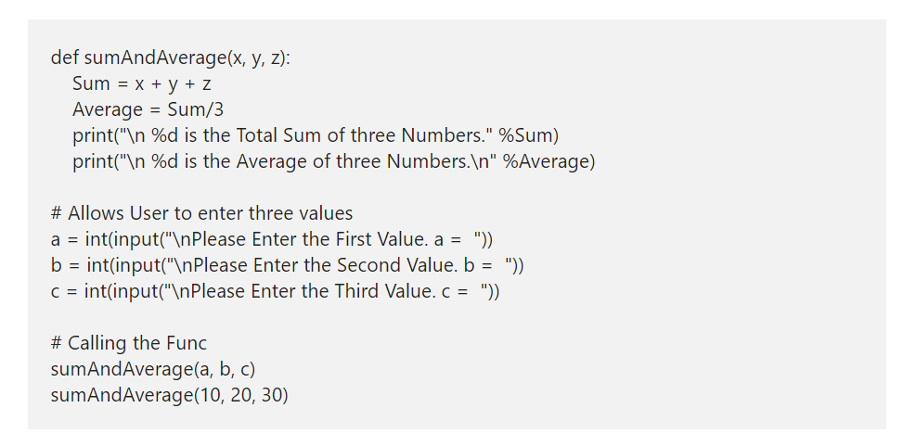
Example function

Slide 7
Types of Functions in Python
In real-time, a Python function may define with or without parameters, and a function may or may not return a value. It entirely depends upon the user requirement. In this article, we explain to you the types of functions in Python Programming language with examples.
In Python programming, as per our requirement, We can define the User defined functions in multiple ways. The following are the list of available types of functions in Python.
Python Function with no argument and no return value.
Function with no argument and with a Return value.
Python Function with argument and No Return value.
Function with argument and return value.

Slide 8
Python Iterator
An Iterator in Python is an Object which contains a countable number of values or elements. You can use this one to Traverse all those elements. The Python iterator uses the special methods called __iter__() and __next__() methods to traverse the object elements.

Slide 9
Python Iterator Vs Iterables
If we can get the Python iterators from it, then we call that object as iterable. So far, we have seen the objects called Lists, Tuples, Sets, and Dictionaries. From these objects, you can call Iter. This section explains how to use this Python class and create our own and infinity iterators with practical examples.

Slide 10
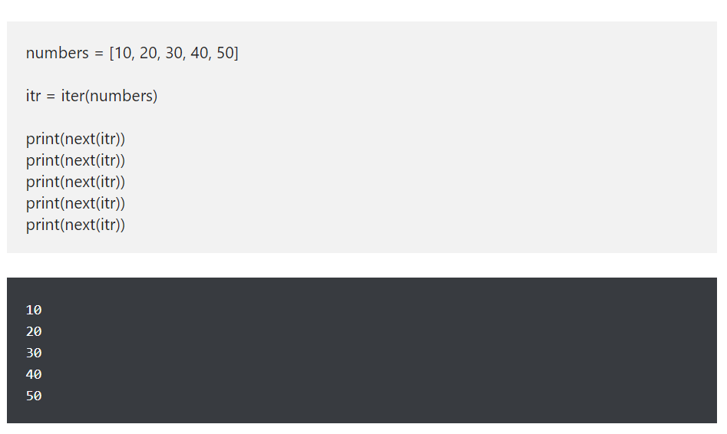
Python List Iterator example

Slide 11
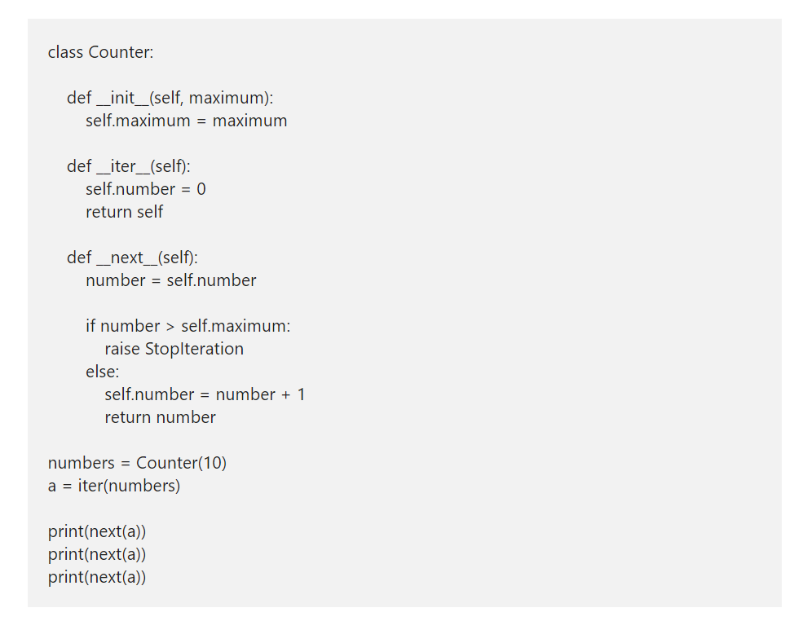
Create Own Iterator in Python

Slide 12
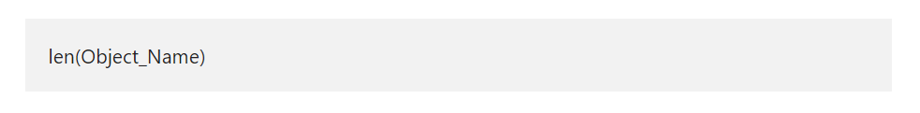
Python len Function
The Python len function finds the length of an object. Or, say, it returns the number of items in a object. If you are finding the string length, then this Python len function returns the total number of characters.
In this section, we discuss how to use this Python len function on String, Tuple, List, Dictionary, Sets, Bytes, and range. The syntax of this function is

Slide 13
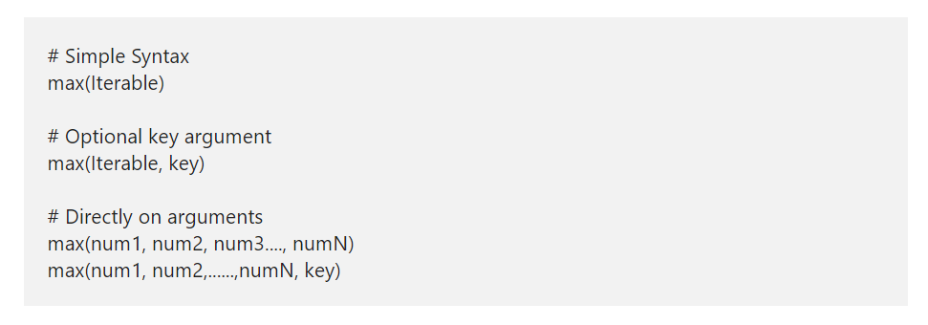
Python max Function
The Python max function is used to find the maximum item of a given object. Or, say, Python max function returns the highest, largest, or biggest items in a given object.
In this section, we discuss how to use this Python max function on Tuple, List, Dictionary, and Sets with practical examples. The syntax of this function is:

Slide 14
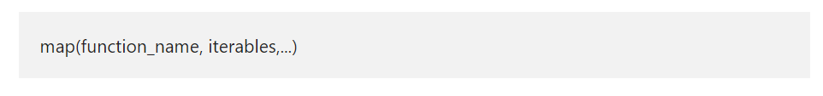
Python map Function
The Python map function applies the user given function to each item in an iterable such as list, tuple, etc. Next, this function returns a list of the result values. In this section, we discuss how to use this along with example and the basic syntax of the Python map function is

Slide 15
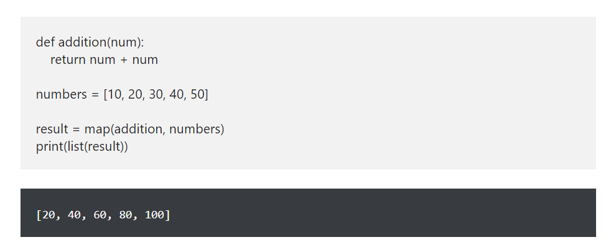
Python map Values Example

Slide 16
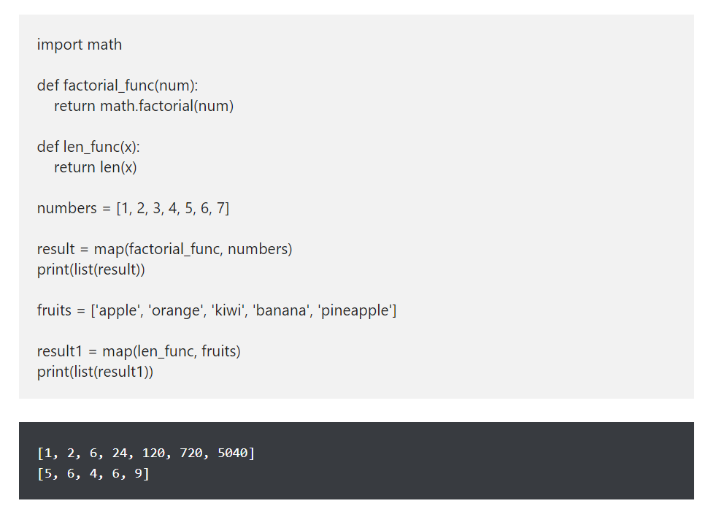
Built-in functions Example

Slide 17
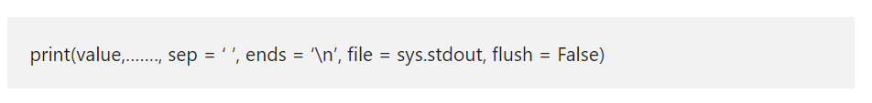
Python print Function
The python print is one of the built-in functions used to display the given value as an output. If you want something to be written o the screen or output device, then you have to use this Python print function.
Let me see the detailed information behind this Python print function arguments:
Value: This Python print function display this value to output or writes it to a file using file argument.
sep: It’s an optional argument. If you specify any string then that string value inserted between values. By default, this value is space.
end: It’s an optional argument. If you have given any string, then that string is appended after the last value. The default value is a newline (\n).
file: This is an optional argument. You can use this to display the output in a text file or something like that. By default, it uses sys.stdout (standard output)
Flush: Change it to true if you want to flush the stream forcibly.

Slide 18
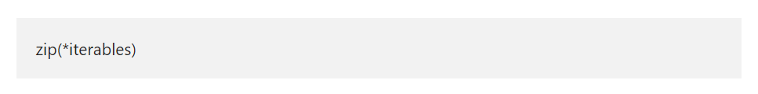
Python zip Function
The Python zip function accepts zero or more iterables and returns an iterator tuple. In this section, we discuss how to use this function to combine iterable items with example. In this function, the iterator object can be list, tuple, string, etc., or you can also use the user-defined iterator. The syntax of the Python zip function is

Slide 19
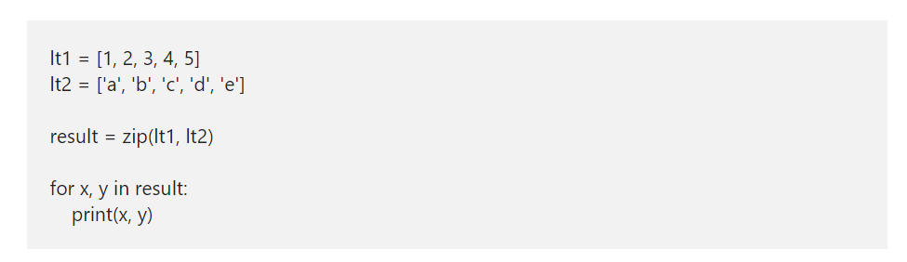
Simple Python zip two lists Example

Slide 20
Python File Handling
Python does support File handing. I mean, Python provides various functions that allow us to create a file, open, read the data, and write data to a file. Unlike other languages, Python handles files differently. Python treats Files as text or binary based on the data, and each line has to terminate with an End Of Line characters like newline, comma, etc.
Python provides an important function called open to work with files. The File open function in Python accepts two parameters, and they are file_name and mode.
The syntax of this Python file open function is -> f_open = open(“File Name”, “mode”)

Slide 21
Python File handling contd.
In the above Python file handling syntax, mode is an optional argument. There are four different modes in Python for opening a file.
r – It means, Read Mode, and this is the Python default mode of the file open. It opens an existing one for reading if there is no such document, then it throws an error.
r+ – This is for both reading and writing mode.
a – Means Append. If it exists, then this opens that one and appends the data to the existing content. If there is none, it creates a new one with the name we specified.
w – Means Write mode. It opens a file in Python write mode and overrides the existing content with new content. It creates a new if it doesn’t exist.
x – Use this to create a new one. It throws an error if it already exists.
Apart from these modes, you can also specify the type of data that the file has to handle. I mean binary data or text mode
t – Text Mode, and this is the default mode.
b – Binary mode.

Slide 22
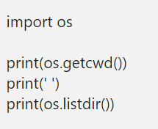
Python Open File
In Python, you can open a file, either specifying the name or the full path. The full name opens it in the current working directory. However, using the full path, you can access documents at any directory. Before we start, let me use the listdir function to get the list in the current directory.
F_open = open(“path/filename.txt”)

Slide 23
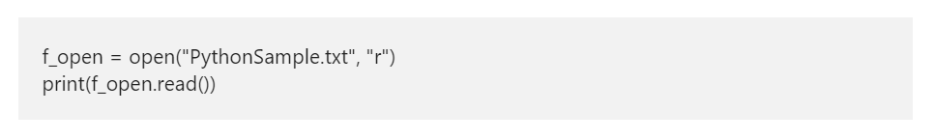
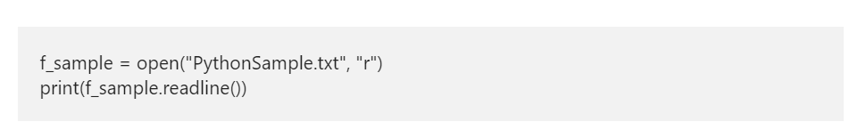
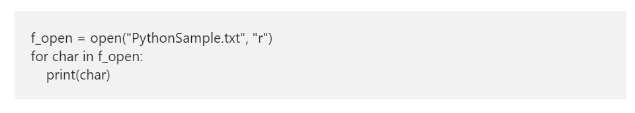
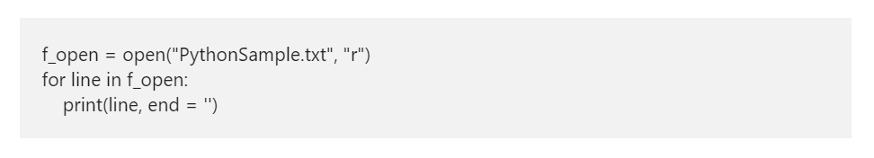
Python read file

Slide 24
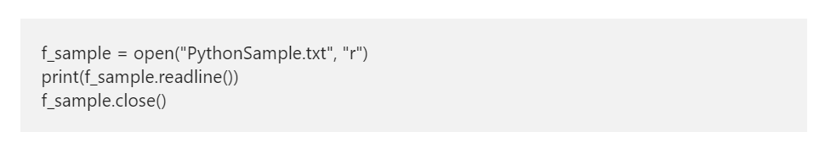
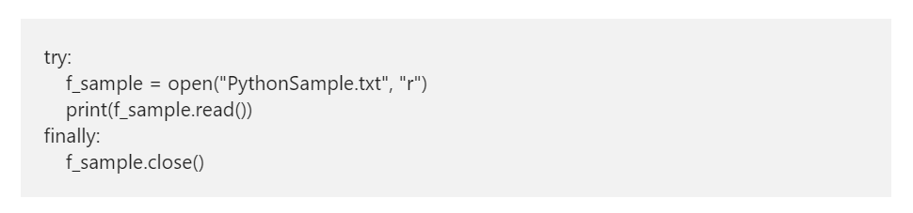
Python close file function

Slide 25
Python Write File
Python provides the write method to write content or data to a file. Before we get into the write function example, I assume you remember what I said earlier. You have to use either a mode for append or w for write mode.
f = open("E:/New folder/Python/sample.txt",'w')
f.write("\nHello, I have written in the file for the second time using write method")
f.close()

Slide 26
Python Directory
While working with files, you should know which Python directory you are using, where your files are storing so on. If you know them, you can easily change the working directories or even create subfolders to organize your files.
In Python, we have an os module, which contains all the necessary functions to work with file directories. So, to work with the methods, you have to import this os module.

Slide 27
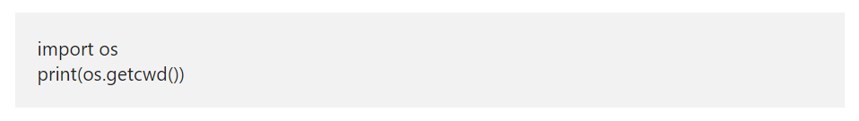
How to Get a Current Directory?
Python getcwd method returns the current working directory. This getcwd function example shows you the same.

Slide 28
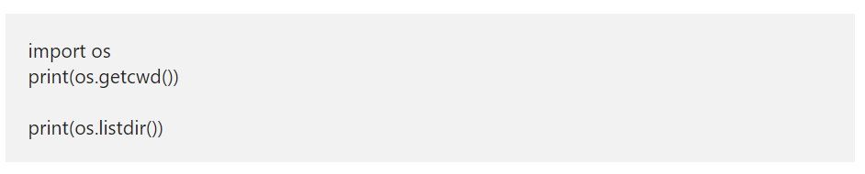
Python Directory and Files list
The listdir method returns all the files and the subfolders available inside that folder.

Slide 29
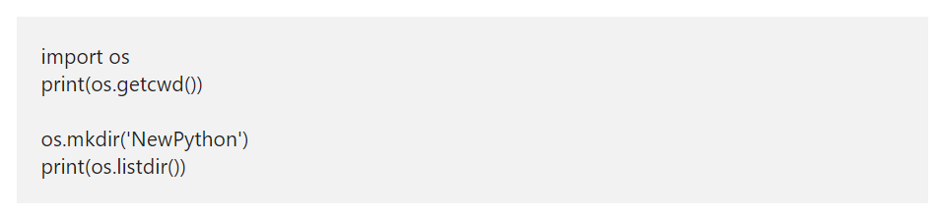
Create a New Directory in Python
The mkdir method creates a new folder. If you want this dir inside the current working folder, then simply specify the folder name; otherwise, specify the full path.

Slide 30
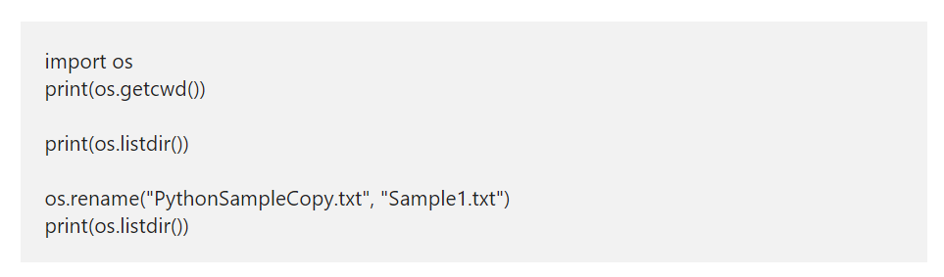
Rename a Directory
The rename function present in the os module helps us to rename existing files or even renaming folders. Here, we use this rename file function to rename PythonSampleCopy to the Sample1 text.

Slide 31
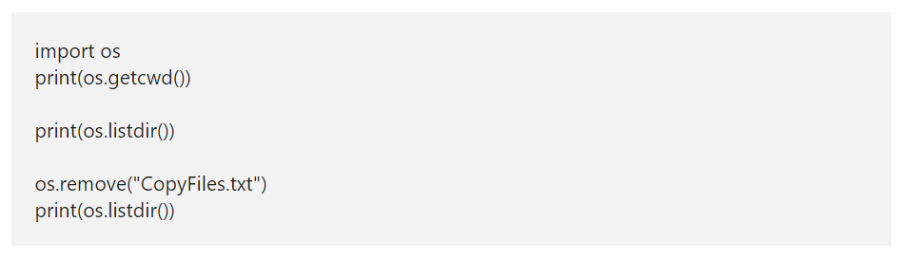
Delete a File
A remove function is to remove files from a folder. This example uses a sample inside the remove function to delete the CopyFile.txt.
First, we are listing out the files in the current working folder. Next, we removed that particular one, and then printing the files.

